Slide 1

2026
FIFTH ANNUAL · SEPTEMBER 14, 2026 · THE STATLER DALLAS
7 CRITICAL NEEDS™
An EOS® Trust Builder™
Walt Brown, Head Coach - EOS Worldwide
Walt.Brown@eosworldwide
eosnorthtexas.com
#WeRunOnEOS2026
Notes:
Title slide. Replace the title, your name, and handle. Leave the logo, event line, and footer as they are.

Slide 2
7 CRITICAL NEEDS™
An EOS® Trust Builder™
Actionable Advantage
eosnorthtexas.com
#WeRunOnEOS2026
Notes:
Almost 15 months ago, June 29th 2025 I was laying on the ceramic tile floor of a condominium we rented in Amelia Island Florida for our extended family July 4th vacation.
And on my chest was my youngest daughter Jane 3rd year medical student and she was in the process of administering 9 minutes of CPR and to her right on her knees was my oldest daughter Marion and Marion was singing the tune staying alive staying alive staying alive La La La La stay alive apparently that is the correct cpr rhythm, standing over them was my wife with one year old granddaughter Ashby
and over the next 18 hours three different times groups of doctors sat down with my wife and daughters and told them these words do not hold out hope, do not hold out hope
I had suffered from what's called an aortic dissection which is basically a big rupture in your aorta above your heart and your heart pumps all of your blood into your chest cavity
it's a big deal they cut me open and went in and replaced my aortic arch with a man made version
during the surgery, my Sister-in-law Dr. Marion and her husband doctor Kelly both surgeons out of Seattle show up and say this to my wife and daughters do not hold out hope and if he does survive, he will had a severe heart attack or a life crippling stroke and then probably will die from complications soon after
Fast forward this past July and I'm sitting on the beach feet in the sand and water one of those low chairs under an umbrella Jane to my left Marion to my right and Jane says you know dad for the first 5 minutes of the 9 minutes you weren't breathing and Marion pipes up yeah dad you were grey I know what a dead person looks like.
Yes, this type of event that will make one reflect and think pretty deeply about why you were left on earth, why St. Peter threw you back…
But I really didn't have to go that far, it was right in front of me, I was left on earth to finish my life’s work, I was left on earth to complete the mission to extend the mission to extend the mission of what I was doing on earth through EOS
And what we do through EOS is we remove the confusion and dysfunction that exists in companies and organizations that holds people back from living in a life of hope and peace we destroy the confusion, and we destroy the dysfunction that creates the fear that creates more confusion and dysfunction that keeps them from living in peace, and hope. 4:26

Slide 3
HEALTHY
eosnorthtexas.com
#WeRunOnEOS2026
Notes:
At EOS we call this Healthy. (Pause, then click to Healthy Matters and Pause)
As in Patrick Lencioni’s Healthy and Smart (Video)

Slide 4
HEALTHY MATTERS™
eosnorthtexas.com
#WeRunOnEOS2026

Slide 5

HEALTHY MATTERS™
eosnorthtexas.com
#WeRunOnEOS2026
Notes:
I’m going to invite in our special guest , Patrick lencioni to explain healthy better than I can. 3:12

Slide 6
HEALTHY MATTERS™
It’s Actionable Advantage
eosnorthtexas.com
#WeRunOnEOS2026
Notes:
Thank you patrick.
I want you to Please reflect on one line from that video: Where he says, and that’s pretty hard to measure, right? and patrick says, Yes it is…. Well today we are leaving that behind.
EOS makes Healthy Actionable - im going to point out that the 7 Critical Needs makes Healthy Measurable

Slide 7
VISION, TRACTION, HEALTHY
eosnorthtexas.com
#WeRunOnEOS2026
Notes:
Vision Traction Healthy The three EOS Core Promise these are our three core promises we make to our clients, our brand promises
And we say:
We work with owners and leadership teams of privately held companies to help them get what they want from their business.
We do this by bringing a complete system with a simple set of tools that when properly installed allows you to permanently enjoy three things we call vision, traction, healthy.
1. Vision, from the standpoint of first getting your leaders 100% on the same page with where your
organization is going and how it is going to get there.
2. Traction, from the standpoint of helping your leaders become more accountable and disciplined, rowing together
executing really well to achieve every part of your vision.
3. Healthy, meaning helping your leaders to become a healthy, functional, cohesive leadership team, because unfortunately, leaders often don’t function well as a team.
From there, as goes your leadership team, so goes the rest of your organization. You get to the point where your entire organization is crystal clear on your vision, all much more and accountable and disciplined, executing well, gaining consistent traction,
And we are Advancing as a healthy, functional, cohesive team.
That’s what I’m selling, would you like to buy some? 1:52

Slide 8

2026
EOS hits a ceiling.
EOS breaks down.
#WeRunOnEOS2026
Notes:
But then,
EOS hits a ceiling.
EOS breaks down.
And it is our fault.
And this is the problem
We are so focused on the Sr. Leadership team that we lose sight of everyone else.

Slide 9
“As goes the leadership team
so goes
the rest of the organization.”
eosnorthtexas.com
#WeRunOnEOS2026
Notes:
We make a bold assumptive claim:
“as goes the leadership team goes so goes the rest of the organization “
And this is what I'm here to talk to you about today
Yeah, EOS does an amazing job in creating clarity around vision at the Sr. Leadership Team Level, and it does a great job to create traction, individual accountability and discipline, at the Sr. Leadership Team Level.
And it does a great job at creating healthy, functional cohesive Senior leadership Teams
Nobody can match us here.
And oftentimes, for smaller companies, for the original core target of EOS, this is enough.
But very, very often: EOS hits the ceiling, it breaks down as we try to get outside of the Sr. Leadership Team.
“as goes the leadership team, so goes the rest of the organization.”
Is a little presumptive. A little open ended. I think it is a little naive. And Frankly it is a bit lazy leaving things to chance.

Slide 10
2026
EOS Breaks Down
#WeRunOnEOS2026
Notes:
Where it breaks down

Slide 11
2026
It fails to reach the
frontlines.
It is never embraced
by our workers.
#WeRunOnEOS2026
Notes:
where it breaks down
is it never gets out to or embraced by the front lines!

Slide 12
2026
No buy in or belief
in EOS®…
especially by
middle management.
#WeRunOnEOS2026
Notes:
where it breaks down
is in the buy in and belief in EOS beyond leadership and management.

Slide 13
2026
Your rollout is a steamroller.
You don’t have
a compelling
message.
#WeRunOnEOS2026
Notes:
where it breaks down is in the rollout,
because you don’t have a message
(Maybe Beth will talk about this later today, maybe.)

Slide 14
2026
And You Hit The Ceiling
Why?
#WeRunOnEOS2026
Notes:
We call this break down Hitting the Ceiling in EOS Language

Slide 15
Your employees,
Feel EOS is being done
To them not For them.
We must flip the script.
eosnorthtexas.com
#WeRunOnEOS2026
Notes:
This is the fact:
Your Employees see EOS as being done to them and not for them,
They do not understand the Why,
They cannot tune into their favorite radio station, WIIFM, what’s in it for me, they do not understand what is in it for them.
We must flip the script – we must have them buy in to the fact that EOS is being done For them and not To them.

Slide 16
Your employees,
Don’t understand the why of EOS.
We must fill in the why gap.
eosnorthtexas.com
#WeRunOnEOS2026
Notes:
This is the fact:
Your Employees see EOS as being done to them and not for them,
They do not understand the Why,
They cannot tune into their favorite radio station, WIIFM, what’s in it for me, they do not understand what is in it for them.
We must flip the script – we must have them buy in to the fact that EOS is being done For them and not To them.

Slide 17
Your employees,
Can’t tune in to WIIFM.
We must help them tune in.
eosnorthtexas.com
#WeRunOnEOS2026
Notes:
This is the fact:
Your Employees see EOS as being done to them and not for them,
They do not understand the Why,
They cannot tune into their favorite radio station, WIIFM, what’s in it for me, they do not understand what is in it for them.
We must flip the script – we must have them buy in to the fact that EOS is being done For them and not To them.

Slide 18
2026
It's time to break through.
#WeRunOnEOS2026
Notes:
We must break through this ceiling… 4:28
So far 4:26, 3:12, 4:28. 11:30 so far.

Slide 19
7 CRITICAL NEEDS™
eosnorthtexas.com
#WeRunOnEOS2026
Notes:
And this is where the 7 Critical Needs come in.
The 7 Critical Needs is the easy how.

Slide 20
7 CRITICAL NEEDS™
An EOS® Trust Builder™
eosnorthtexas.com
#WeRunOnEOS2026
Notes:
The 7 Critical Needs has been added as an official EOS Trust Builder.
It is part of the EOS Cannon – can I get an Amen.
As Gino says: “This is proven, we are not practicing on you.”

Slide 21

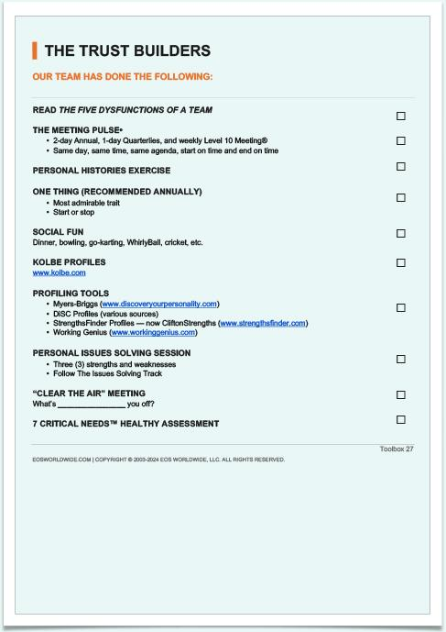
Trust
Builder
2026
#WeRunOnEOS2026
Notes:
Why this is significant.
The last time a tool was added to the trust builder toolbox was back in 2019 - Patrick Lencioni’s 6 working geniuses.
There were none before.
Across the entire tool box, there have only been 1 or 2 other changes or additions. We took out the Assistance Track and added in the 5 Rule of the Game…
This is significant.

Slide 22
7 CRITICAL NEEDS™
An EOS® Trust Builder™
Actionable Advantage
eosnorthtexas.com
#WeRunOnEOS2026
Notes:
The 7 Critical Needs has been added as an official EOS Trust Builder.
It is part of the EOS Cannon – can I get an Amen.
As Gino says: “This is proven, we are not practicing on you.”

Slide 23
7 CRITICAL NEEDS™
Discovery
eosnorthtexas.com
#WeRunOnEOS2026
Notes:
May I tell you a little discovery story its called the story around the Millennial Myth.
OK back in 2014, I was on EOS client number 72 or so, I’d been implementing EOS for 7 years. and was back when everyone was complaining about millennials
and when I sat back and looked at all the complaints about millennials about how they were skipping jobs and bought not bought in and not dependable same complaints about every new generation I scratched my head and said I I'm not seeing that with my client as a matter of fact my client’s millennials are completely blowing up the stereotype and tearing up the mold
My question was, what are we doing through EOS that's breaking the pattern and what I did was this.
What I did was I asked my clients for permission to engage with their millennials in focus groups and conversations to figure out what it was that we were doing that was breaking the mold and blowing up the stereotype, and after about nine months a very clear pattern emerged, and this was the pattern

Slide 24
2026
Asking themselves:
Do I Belong?
#WeRunOnEOS2026
Notes:
Millennials were asking themselves 7 questions about work, they were running a mental rubric, asking themselves questions about where they were working,
They were asking themselves do I belong here

Slide 25
2026
Asking themselves:
Do I Believe?
#WeRunOnEOS2026
Notes:
they were asking themselves do I believe, and what this company is all about

Slide 26
2026
Asking themselves:
Do I understand and embrace
what I’m Accountable for?
#WeRunOnEOS2026
Notes:
they were asking themselves do i understand and embrace what I'm accountable for especially as it ties to what I'm being asked to believe

Slide 27
2026
Asking themselves:
Do I understand and embrace
how I’m Measured?
#WeRunOnEOS2026
Notes:
do I understand and embrace how I'm being measured is it fair

Slide 28
2026
Asking themselves:
Do I understand and embrace
how I’m Heard?
#WeRunOnEOS2026
Notes:
they were asking themselves to understand and embrace how this organization listens, asking am I being heard

Slide 29
2026
Asking themselves:
Do I understand and embrace
how I’m Developed?
#WeRunOnEOS2026
Notes:
and they were asking themselves to understand how can I, be involved in my own development and am I am I being developed am I developing?

Slide 30
2026
Asking themselves:
Do I understand and embrace
how I maintain Balance?
#WeRunOnEOS2026
Notes:
and finally, they were asking themselves about balance, is this a place where I can maintain balance both work life and how much the job pays – to make ends meet.

Slide 31
2026
Asking themselves:
Do I Stay or do I Go? No = Go!
Do I Belong?
Do I Believe?
Am I Accountable?
Am I Measured?
Am I Heard?
Am I Developed?
Am I Balanced?
Stay or Go?
Stay or Go?
Stay or Go?
Stay or Go?
Stay or Go?
Stay or Go?
Stay or Go?
#WeRunOnEOS2026
Notes:
those were the seven questions and ultimately those seven questions turned into a mental stay or go rubric, and if they couldn't get to yes on any one of the seven, then it was a go decision for them

Slide 32
2026
Questions became Needs:
The need To Belong
to a group whose values
align with your own.
#WeRunOnEOS2026
Notes:
ultimately these seven questions turned into what we call the7 critical needs that every employee has at work
the need to belong to group whose values align with our own.

Slide 33
2026
Questions became Needs:
The need To Believe
in the product, the mission and
the strategy for achieving it.
#WeRunOnEOS2026
Notes:
the need to believe in the mission and the strategy for achieving it

Slide 34
2026
Questions became Needs:
The need to Be Accountable
for something meaningful.
#WeRunOnEOS2026
Notes:
the need to be accountable for something meaningful

Slide 35
2026
Questions became Needs:
The need to Be Measured
fairly.
#WeRunOnEOS2026
Notes:
the need to be measured fairly

Slide 36
2026
Questions became Needs:
The need to Be Heard
honestly.
#WeRunOnEOS2026
Notes:
the need to be heard honestly

Slide 37
2026
Questions became Needs:
The need to Be Developed
intentionally.
#WeRunOnEOS2026
Notes:
the need to be developed intentionally and

Slide 38
2026
Questions became Needs:
The need to Be Balanced
sustainably.
#WeRunOnEOS2026
Notes:
the need to be balanced sustainably 5:08
So far 4:26, 3:12, 4:28, 5:08 = 16:38 so far.

Slide 39

2026
Forcing
#WeRunOnEOS2026
Notes:
EOS. And what was happening with these millennials and in these companies, through an EOS implementation was EOS was forcing each company to come to grips with and be honest about what it means to belong at their organization they were defining their core values and they were hiring, firing rewarding and recognizing based on their values they're recruiting people in who had the skills to do the job, so people knew they belonged
and it was forcing the companies to come to grips with what they were asking people to Believe. all the answers captured in our Vision Traction Organizer what's our core focus what's our niche what's our 10 year target what's our marketing strategy what's our three-year picture what's our one year plan what is our focus for the next 90 days and what are the issues that we know are out there but aren't getting worked on
it was forcing the organization to get super clear on what people were accountable for, super clear role clarity that tied to seat, what were the rocks they were committing to and we're accountable for what about the 7 Day two do they took from the weekly level 10
and then heard, it was forcing the organization to simplify and get comfortable and consistent with how the organization listens. So the individual knew when the channels open and when they closed. of course level 10 meetings IDs scorecards quarterly conversations
it was forcing the organization to simplify how it offered people opportunities for development developing through identify discuss and solve, having open conversations during quarterly conversations around getting wanting and having the capacity to do each one of your roles – being developed during the issue solving of a meeting
and ultimately was balanced. through meetings like the quarterly conversation where you're sitting down and talking about the capacity of each one of your roles and then clearly how much time the job took and what the job paid EOS was doing all of this work. 3:41
So far 4:26, 3:12, 4:28, 5:08, 3:41 = 20:54 so far.

Slide 40
2026
The 7 Critical Needs
is how we break through
the ceiling.
With our people, they pull.
#WeRunOnEOS2026
Notes:
EOS Coupled with the 7 Critical Needs is how we break through the ceiling.

Slide 41
2026
With our people so they Pull.
How we flip the script.
How we explain the Why.
How they tune in to WIIFM.
We Make EOS For them.
#WeRunOnEOS2026
Notes:
So they Pull. With our people, This is how we break through the ceiling and keep breaking through – with our people.
With our people, This is how we flip the script,
This is how we explain that EOS is for you, not to you,
With our people, this is how we explain The Why EOS,
This is how we explain WIIFM.
This is how we get EOS Rolled out to and for the Front Line. :30
So far 4:26, 3:12, 4:28, 5:08, 3:41, :30 = 23:03 so far.

Slide 42
2026
Inside EOS - We Believe:
“What gets measured gets done.”
“You must inspect what you expect.”
#WeRunOnEOS2026
Notes:
Inside of EOS we believe that “what gets measured gets done”
And we believe “you must inspect what you expect”
And thank you to our Millennials for building the Rubric we will use.
in this case the seven critical needs become the Healthy rubric

Slide 43
2026
Inside EOS - We Believe:
“What gets measured gets done.”
“You must inspect what you expect.”
Thank you Millennials for the rubric!
#WeRunOnEOS2026
Notes:
Inside of EOS we believe that “what gets measured gets done”
And we believe “you must inspect what you expect”
And thank you to our Millennials for building the Rubric we will use.
in this case the seven critical needs become the Healthy rubric

Slide 44
2026
7 Critical Needs become
Your “Healthy” Measurement
To Belong?
To Believe?
To Be Accountable?
To Be Measured?
To Be Heard?
To Be Developed?
To Be Balanced?
1-10?
1-10?
1-10?
1-10?
1-10?
1-10?
1-10?
#WeRunOnEOS2026
Notes:
in this case the seven critical needs become the Healthy rubric = we now have measurable organizational health, not some touchy feely thing.
Remember Patrick earlier saying it is hard to measure…. Well, not any more.

Slide 45
2026
7 Critical Needs become
Your Measurable Org Health Tool
To Belong?
To Believe?
To Be Accountable?
To Be Measured?
To Be Heard?
To Be Developed?
To Be Balanced?
1-10?
1-10?
1-10?
1-10?
1-10?
1-10?
1-10?
#WeRunOnEOS2026
Notes:
it becomes the Measurable Organizational Health Rubric
We survey our people - asking them on a scale of 1 to 10 how they feel about each of their critical needs being met. I’ll share the survey and Scoring with you in Q and A.

Slide 46
MEASURABLE HEALTHY MATTERS™
eosnorthtexas.com
#WeRunOnEOS2026
Notes:
Healthy Matters

Slide 47
MEASURABLE HEALTHY MATTERS™
YOUR ACTIONABLE ADVANTAGE
eosnorthtexas.com
#WeRunOnEOS2026
Notes:
Healthy Matters

Slide 48
2026
No Additional Tools Required
“The Answer is in the Tools.” - Walt
#WeRunOnEOS2026
Notes:
Remember “the answer is in the tools, you don’t need anymore tools”

Slide 49
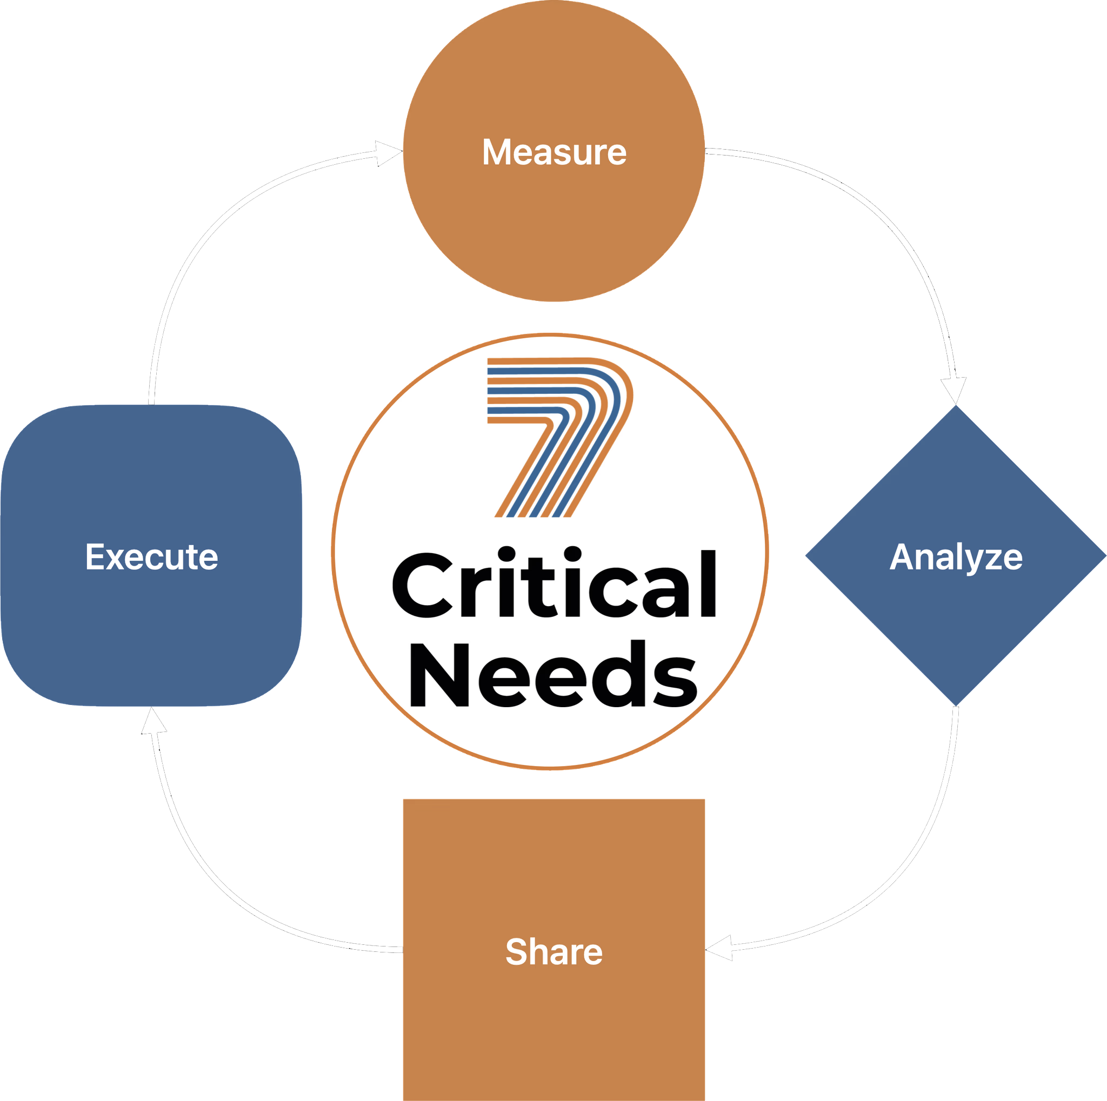
Proven Process
2026
#WeRunOnEOS2026
Notes:
This is our proven process. 4 steps measure, analyze come up with a plan, share the plan, execute the plan, then measure again

Slide 50
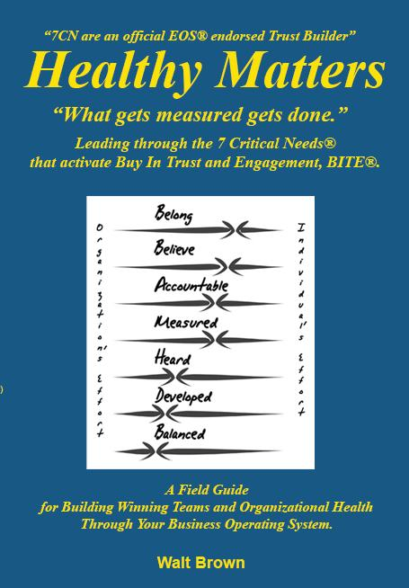
2026
#WeRunOnEOS2026
Notes:
and how you go about doing this is right here in this little field guide I've shared with you called Healthy Matters and you can dig into this you can give us or your Implementer a call

Slide 51
7 CRITICAL NEEDS™
An EOS® Trust Builder™
eosnorthtexas.com
#WeRunOnEOS2026
Notes:
2:16
So far 4:26, 3:12, 4:28, 5:08, 3:41, :30, 2;16 = 22:49 so far.

Slide 52
2026
Questions? Thoughts?
#WeRunOnEOS2026
Notes:
Section break. Replace the two lines with your section name — keep the flame/orange two-tone. Duplicate this slide for each section.

Slide 53
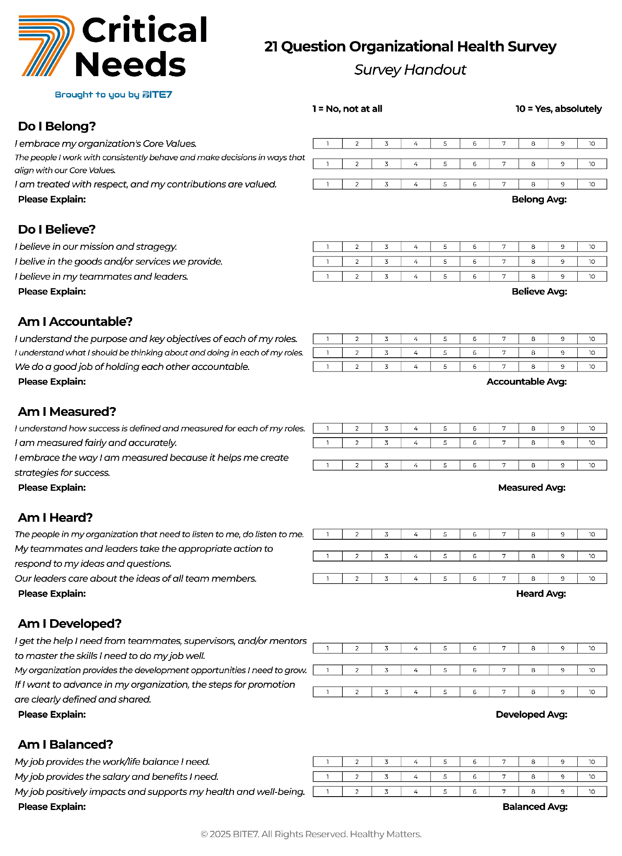
Assessment
Platform
2026
#WeRunOnEOS2026
Notes:
and how you go about doing this is right here in this little field guide I've shared with you called Healthy Matters and you can dig into this you can give us or your Implementer a call

Slide 54
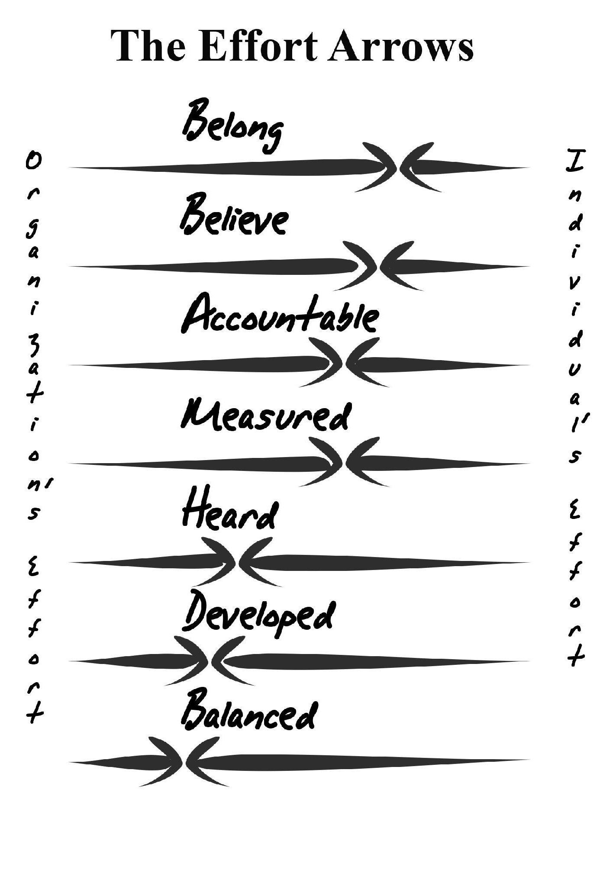
Effort
Arrows
2026
#WeRunOnEOS2026
Notes:
and how you go about doing this is right here in this little field guide I've shared with you called Healthy Matters and you can dig into this you can give us or your Implementer a call

Slide 55
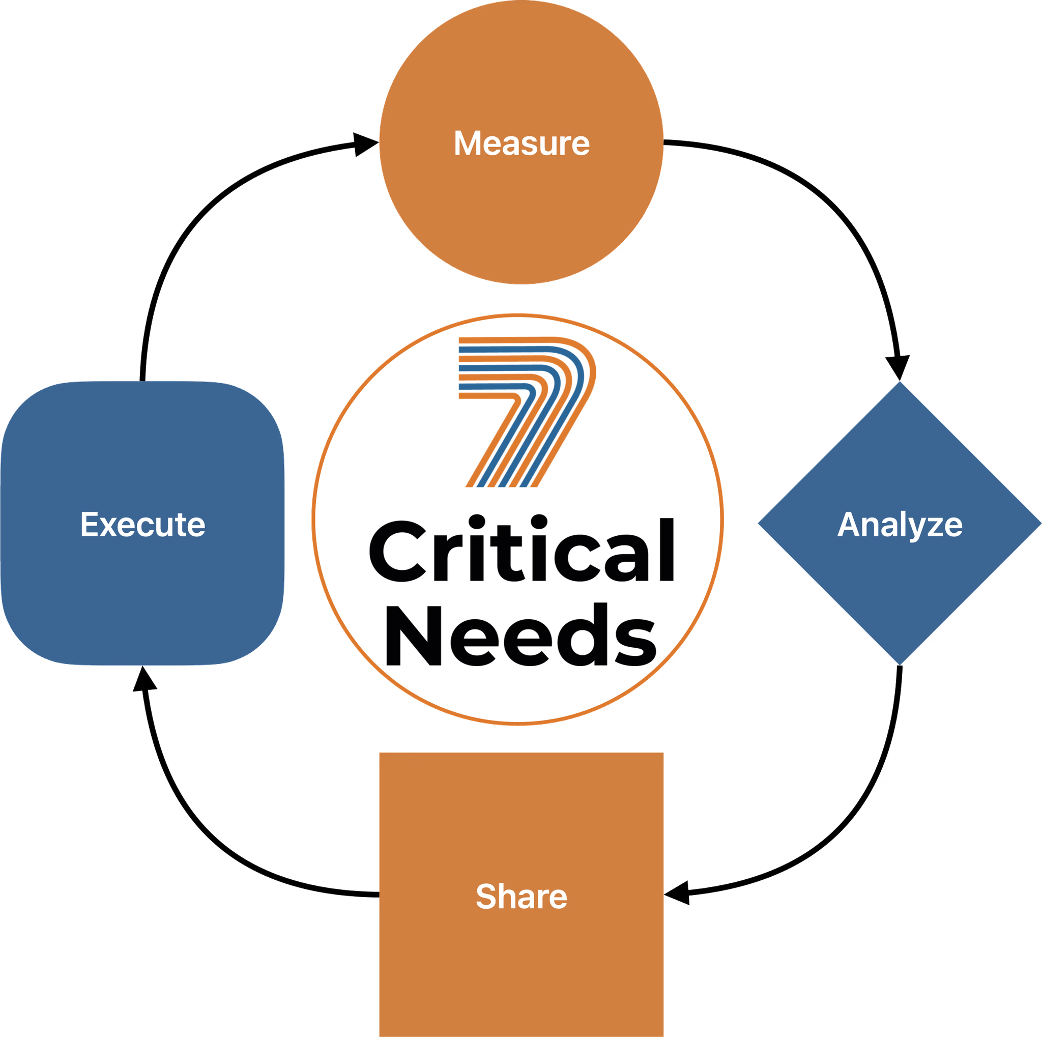

Proven Process
2026
#WeRunOnEOS2026
Notes:
Big graphic. Drop in a diagram, chart, or screenshot — it will aspect-fit, never stretch. Arrange or crop as needed.

Slide 56
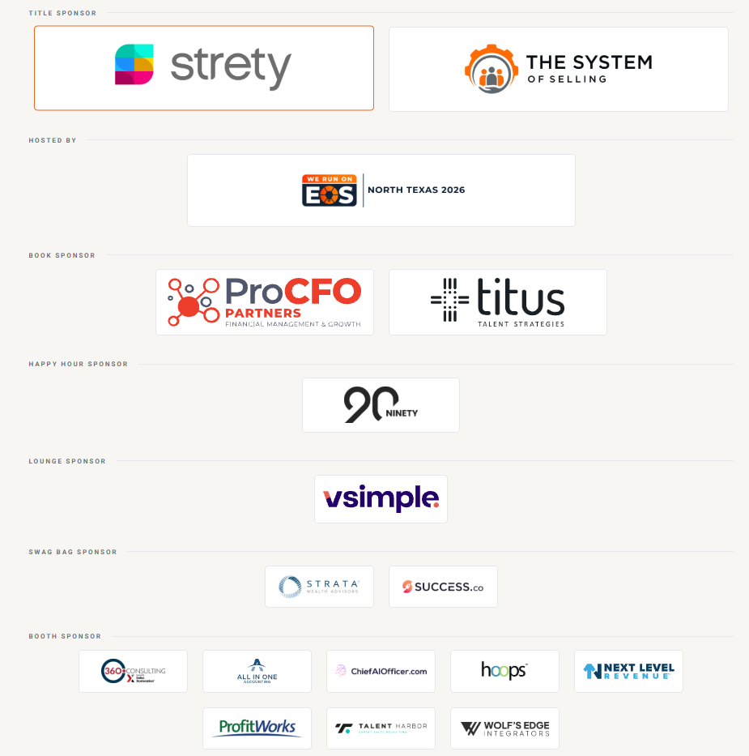
Thank You to Our Sponsors
Notes:
Sponsor thank-you. Logos are current as of the 2026 site — keep this slide as-is and show it at the end of your session.

Slide 57
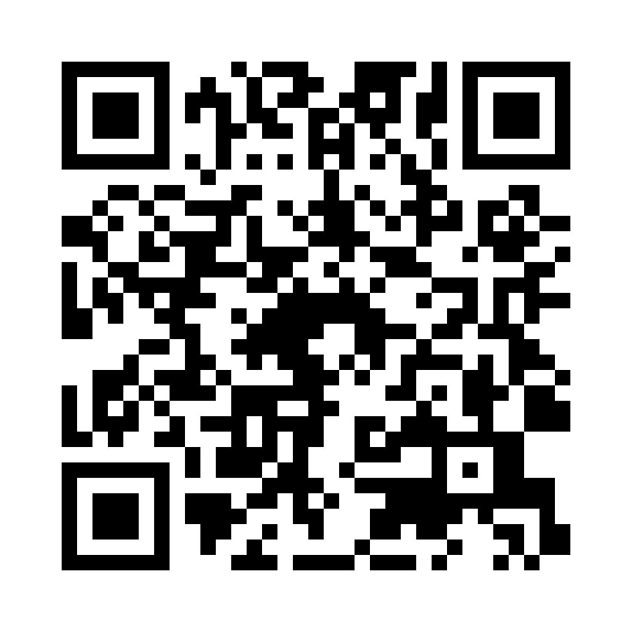
Session Survey
Scan the code to share quick feedback on this session.
Thank you for your feedback.
#WeRunOnEOS2026
Notes:
Session survey. Drop the survey QR code onto the white card. Leave this up while you take questions.

Slide 58
2026
Thanks, y’all!
FIFTH ANNUAL · SEPTEMBER 14, 2026 · THE STATLER DALLAS
eosnorthtexas.com
#WeRunOnEOS2026
Notes:
Closing slide. Swap in your handle so the room can find you.

